Slide 1
Chapter 4
Entity Relationship (ER) Modeling

Slide 2
Chapter 4 (beginning – till page 146)
Will cover Relationship Strength next day (pages 123-125)
Will cover Associative (Composite) Entities next day (pages 136-137)
Relationship Degree -Ternary relationship is not included in the course (unary and binary relationships are included in the course (page 131)

Slide 3
The Entity Relationship Model (ERM)
Forms the basis of an entity relationship diagram (ERD)
  Conceptual database
Database’s main components
  Entities
  Attributes
  Relationships

Slide 4
Entities are represented by rectangles
Here, Customer is the entity for which we want to store data
The customer entity has 8 Attributes
CustomerID is the primary key.
Primary key should always be underlined in a conceptual modeling. This is very important concept. If you forget to underline primary key in your design, points will be deducted.
Customer
CustomerID
LastName
FirstName
Phone
Address
City
State
ZipCode

Slide 5
Entity Class
Customer
Entity/Class Name
CustomerID
LastName
FirstName
Phone
Address
City
State
ZipCode
Attributes/Properties
Entity Class

Slide 6
Types of Attributes
Required vs Optional
Simple vs Composite
Single-valued vs Multivalued
Stored vs Derived

Slide 7
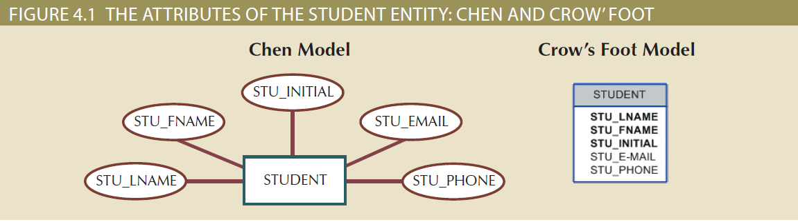
Required vs Optional Attributes

Slide 8
Composite and Multivalued Attributes
Attribute types:
  Simple (atomic) vs. composite attributes
    cannot be subdivided can be subdivided
    e.g., Gender, Age, First_Name e.g. Name (last, first, middle); Address (street#, city, state, ZIP_Code)
  Single-valued vs. Multi-valued attributes
  one value only more than one value
    e.g. hobbies for a person

Slide 9
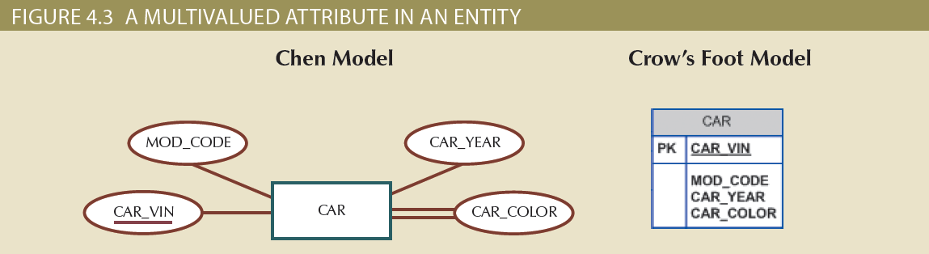
Multivalued Attributes

Slide 10
Courses of Actions for Multivalued Attributes
Requirements of multivalued attributes
  Create several new attributes, one for each component of the original multivalued attribute
  Develop a new entity composed of the original multivalued attribute’s components

Slide 11
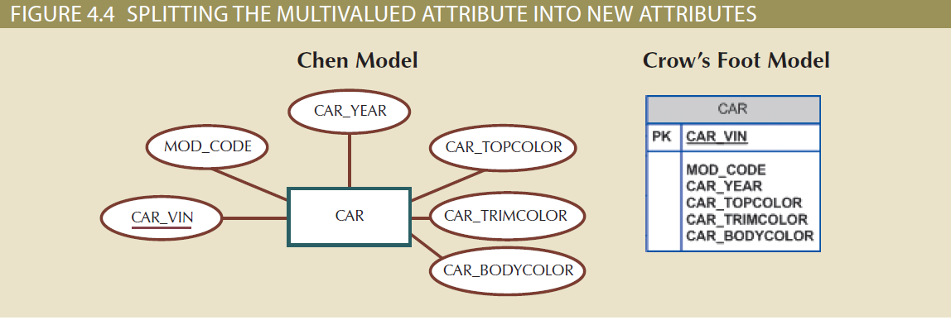
Create several new attributes

Slide 12
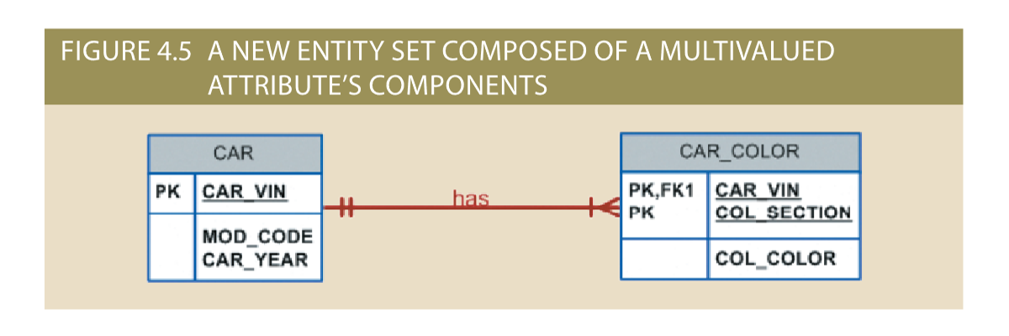
Develop a new entity

Slide 13
Derived/Computed Attributes
Denote computed values with a preceding slash (/).
Employee
EmpID
Name
DateOfBirth
/Age
Phone
…
{Age = Today - DateOfBirth}
Derived attribute: attribute whose value is calculated from other attributes.
  Derived using an algorithm

Slide 14
To store or not to store Derived attribute
Table 4.2 | Advantages and Disadvantages of Storing Derived Attributes
 | Derived Attribute: Stored | Derived Attribute: Not Stored
Advantage | Saves CPU processing cycles Saves data access time Data value is readily available Can be used to keep track of historical data | Saves storage space Computation always yields current value
Disadvantage | Requires constant maintenance to ensure derived value is current, especially if any values used in the calculation change | Uses CPU processing cycles Increases data access time Adds coding complexity to queries

Slide 15
Few other important characteristics of entities
Characteristics of entities
  Domain: set of possible values for a given attribute
  Identifier: one or more attributes that uniquely identify each entity instance
  Composite identifier: primary key composed of more than one attribute

Slide 16
Relationships
Association between entities that always operate in both directions
  Participants: entities that participate in a relationship
The relationships are realized through the primary key – foreign key pairing.

Slide 17
Describing Relationships
The relationship is often associated with a verb that logically describes the relationship between an instance of one entity and another.
  A faculty member ADVISES students
  A salesperson SERVICES customers
  A customer ORDERS products
  An actor PLAYS a role
  A network AIRS programs

Slide 18
Relationships (Connectivity)
The term connectivity is used to describe the relationship classification.
One-to-one (1:1) relationship
  Usually few, if any, in a relational database design
One-to-many (1:M) relationship
  The norm in a relational database design
Many-to-many (M:N) relationships
  Cannot be implemented as such in the relational model
  M:N relationships converted into two 1:M relationships

Slide 19
Cardinality
cardinality expresses the minimum and maximum number of entity occurrences associated with one occurrence of the related entity

Slide 20
Participation in a relationship
Two choices
  Optional – There are some instances that do not participate in the relationship
  Mandatory – All instances participate in the relationship
  These choices are based on business rules

Slide 21
Relationships
How do you read the below diagram?
WOMAN
0
CHILDREN
A woman can have zero or many children, but a child belongs to one and only one mother
0 Optional participation
Mandatory participation
0
none or one
one and only one
0
none or more
one or more

Slide 22
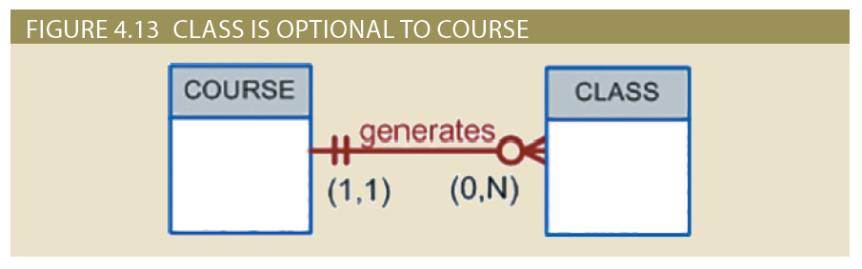
Relationship Participation

Slide 23
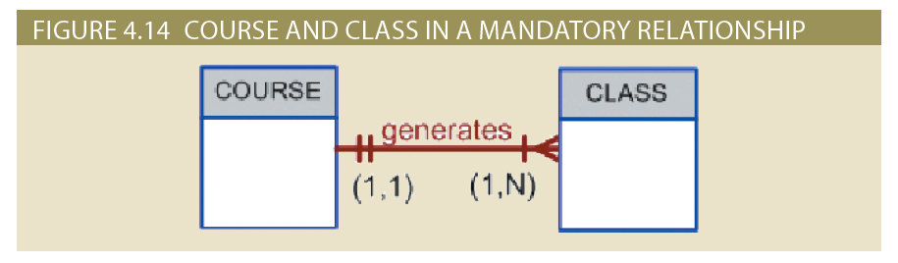
Relationship Participation

Slide 24
Existence Dependence
Existence dependence
  Entity exists in the database only when it is associated with another related entity occurrence
Existence independence
  Entity exists apart from all of its related entities
  Referred to as a strong entity or regular entity

Slide 25
Weak Entities (1 of 3)
Conditions of a weak entity
  Existence-dependent
  Has a primary key that is partially or totally derived from parent entity in the relationship
Database designer determines whether an entity is weak
  Based on business rules

Slide 26
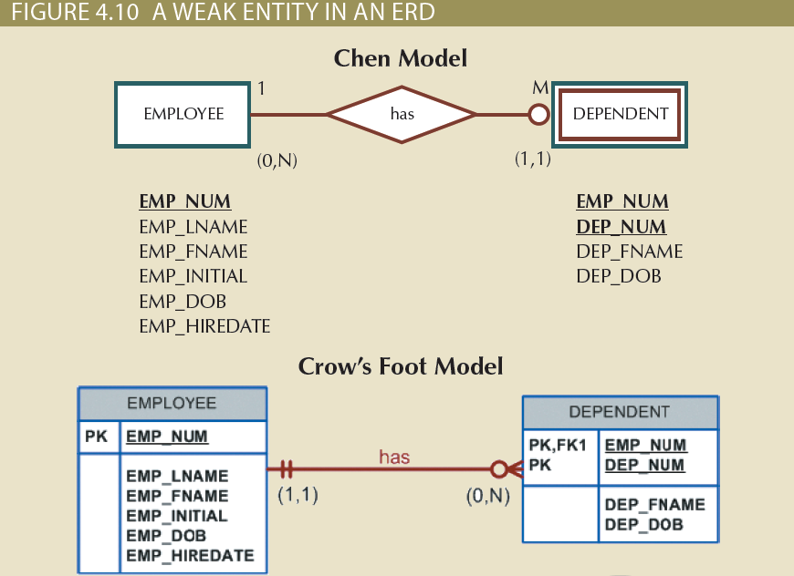
Weak Entities (2 of 3)

Slide 27
Relationship Degree (1 of 2)
Indicates the number of entities or participants associated with a relationship
  Unary relationship: association is maintained within a single entity
  Binary relationship: two entities are associated

Slide 28
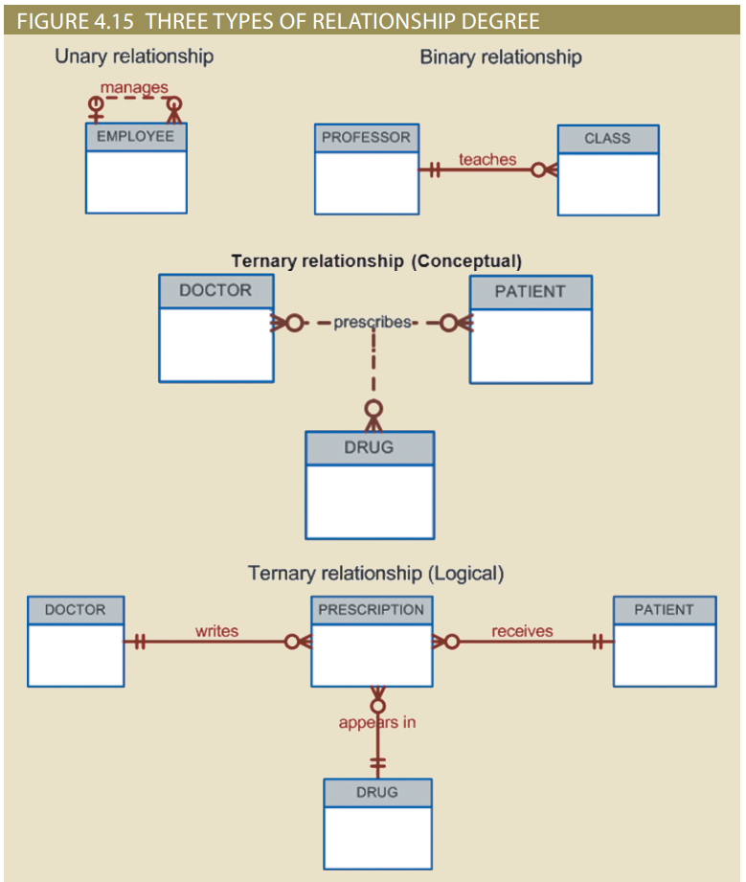
Relationship Degree (2 of 2)

Slide 29
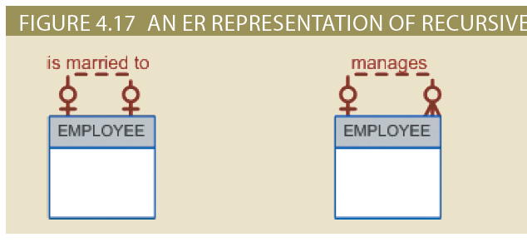
Recursive Relationships

Slide 30
Developing an ER Diagram
Activities involved in building an ERD
  Create a detailed narrative of the organization’s description of operations
  Identify business rules based on the descriptions
  Identify main entities and relationships from the business rules
  Develop the initial ERD
  Identify the attributes and primary keys that adequately describe entities
  Revise and review ERD

Slide 31
Summary
The ERM uses ERDs to represent the conceptual database as viewed by the end user
Connectivity describes the relationship classification (1:1, 1:M, or M:N)
In the ERM, an M:N relationship is valid at the conceptual level
Database designers, no matter how well they can produce designs that conform to all applicable modeling conventions, are often forced to make design compromises

